Slide 1
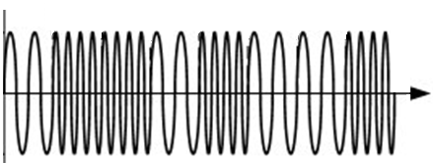
1
0
0
1
0
1
1
0
1
0
time
-1
f₀
f₁

